Slide 1
Network Measurement and Data Analysis Lab
Alessandro Redondi, Francesco Musumeci
Notes:
Inizio

Slide 2
Network Measurement Lab

Slide 3
Course Introduction

Slide 4

Teacher
Prof. Alessandro E. C. Redondi
Office:
Currently without
E-mail: alessandroenrico.redondi@polimi.it
Office hours:
Send me an email

Slide 5
Course organization
Two modules:
Network measurement lab (with me) – 2CFU: how to get network data
Network data analysis lab (with prof. Musumeci) – 3CFU: how to analyse network data
Mix (this module):
5 lectures, 4 hours each
Lecture: (about) 6 hours
Practical activities: (about) 14 hours
Practical activities to be performed on each student’s laptop (BYOD)

Slide 6
Evaluation
Total of 32 points over the two modules
Network measurement lab: 13 points (homeworks)
Network data analysis lab: 19 points (practical project with group oral discussion)
Final score: NM+NDA (only if NM≥7 && NDA≥11). Laude if ≥ 31.
Homeworks
Three homeworks will be assigned, regarding the activities performed in class
Each homework will have a deadline before the end of the course
Homeworks are individual - no groups are allowed
Oral exam
An oral exam can be requested on my discretion

Slide 7
Goal of this module
Why measuring a network?
Types of network measurements
The network analyst toolset
Visualization techniques for network measurements
Applications
Traffic classification / prediction
Wi-Fi sniffing (single-point / multi-point)

Slide 8
What is the Internet
The Interconnection of networks
Hosts (PC, laptop, smartphones, Web servers) connected to the internet can send and receive data to other hosts.
Data is carried by packets which are forwarded along a network path formed by one or more links joined by network elements such as routers or switches.

Slide 9
What is the Internet

Slide 10
Internet Protocols
The structure of a data packet is defined by specific network protocols. Each technology (LAN, Wi-Fi, cellular, IoT, etc.) defines its own packet structure...
... which sooner or later becomes an Internet Protocol (IP) packet.
IP packets comprise a payload, which contains the data and a header, which contains the information each network element needs to determine over which link to forward the packet.
Each host in the Internet possesses one or more IP addresses (32bits numbers in v4 or 128bits in v6)

Slide 11
IP Packet header
The IP header contains the IP address of both its source and destination.
An IP router maintains a routing table which determines the link over which a given packet is to be forwarded based on the packet’s destination IP address.
The IP header contains other elds, such as a checksum of the header contents (to detect bit errors) and time-to-live (TTL), an initially positive integer that is decremented by each router.
Q: What happens if the TTL reaches zero?

Slide 12
Transport protocols
Applications running on hosts do not use the IP protocol directly, but they interact through a transport layer.
The IP payload includes the transport protocol header, which contains the source and destination ports (16bit numbers).
Two transport protocols are predominant: UDP and TCP. While UDP provides a transparent interface to IP, TCP provides facilities to detect or recover from loss of packets in transmission.
Q: What additional information are contained in the TCP header?

Slide 13
Network measurements

Slide 14
Why measuring?
When you can measure what you are speaking about, and express it in numbers, you know something about it; but when you cannot measure it, when you cannot express it in numbers, your knowledge is of a meagre and unsatisfactory kind. (Lord Kelvin)

Slide 15
Why measuring a network
Without measurements, we would not have objective records or benchmark of how a network behaves.
Measurements show whether changes improve or degrade the network performance, and by how much.
Similarly, by measuring the network behaviour and comparing it to the benchmark, we can also identify if something has changed!

Slide 16
Classification of network measurements
Active VS Passive
Physical Layer VS Upper Layers
Packet-level VS Flow-level
Single point VS Multi-point
Network VS Application

Slide 17
Active VS Passive measurements
Active measurements: obtained through injected traffic.
Used for fault/vulnerability detection, network/application performance tests.
Impose extra traffic on the network (most operators are unwilling to do so)
Can distort the network behaviour in the process
Scalability issues (large number of trials)
Examples: ping, iperf, traceroute

Slide 18
Active VS Passive measurements
Passive measurements: observation of existing traffic
Do not inject extra traffic
Observe network packets and connections (flows) in details
Massive amount of data (hardware and memory issues)
Legal issues
Examples: tcpdump, WireShark, DPI

Slide 19
Physical vs Upper layers
Physical measurements can be always obtained, regardless of the upper layers protocol used.
Mostly used in cellular/wireless networks (LTE, Wi-Fi, Bluetooth, Sensor Networks..). Evaluated on a frame-basis.
Received signal strength (RSS)
Channel quality indicator (CQI)
Modulation and coding scheme (MCS)
Bit error rate (BER)
Throughput (THR)
Upper layers measurements generally used in IP-based networks.

Slide 20
Packet-level VS Flow-level
Packet-level: miscroscopic scale, every single packet that travels across the measurement point is captured
Collected information:
Source and Destination IP addresses
Source and Destination ports
(statistics on) packet size, timestamp
protocol information
application data
Storing packet traces is costly! Need for high-end network interfaces, high CPU power and massive data storage capabilities!
De facto standard: libpcap/WinPcap library (tcpdump, Wireshark)

Slide 21
Packet-level VS Flow-level
Flow-level: macroscopic scale, packets are aggregated into flows
Flow: set of packets that share origin and destination address and ports, observed within a pre-defined time frame.
Collected information:
Source and Destination IP addresses
Source and Destination ports
Type of transport protocol
Flow size, duration, bitrate
Number of flows per unit time
De facto standard: Cisco NetFlow

Slide 22
Single-point vs multi-point
Depending on the analysis task, tra c can be captured at different monitoring points
In general it is much simpler to observe tra c at the ingress/egress links of the target network (e.g., customs and border protection)

Slide 23
Network vs Application measurements
Sometimes, one is interested in the performance of a specific application rather then the overall network.
Example: monitor the performance of HTTP downloads through different providers.
In these cases, it is easier to get measurements through specific application tests rather than synthesise them from the packet-level or flow-level data

Slide 24
Active measurements

Slide 25
Active measurements
Active measurements are primarily used for testing the correct behaviour of a network. Most common tools:
Packet INternet Groper (ping)
traceroute
Iperf
Simple Network Monitoring Protocol (SNMP)

Slide 26
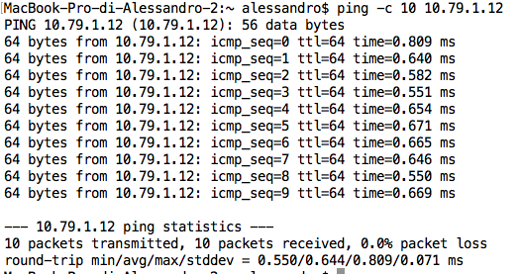
PING
Written in 1983 as a tool to troubleshoot problems in IP networks
Based on the Internet Control Message Protocol (ICMP): echo request followed by echo reply
Measures the round-trip time (RTT) between the source and a given destination

Slide 27
Traceroute
traceroute can be used to analyse a route from a source to a given destination.
How does it work?
Send an ICMP Echo request/UDP packet to the destination with TTL = 1. The first router will decrement the TTL and reply to the source with an ICMP TTL exceeded message.
Now we now the address of the first router on the route.
Send another ICMP Echo request with TTL = 2. Now we now the address of second router.
Continue up to a pre-defined TTL (max number of hops).
Issue: no guarantee that every packet will follow the same path (routing decisions, load balancers...)

Slide 28
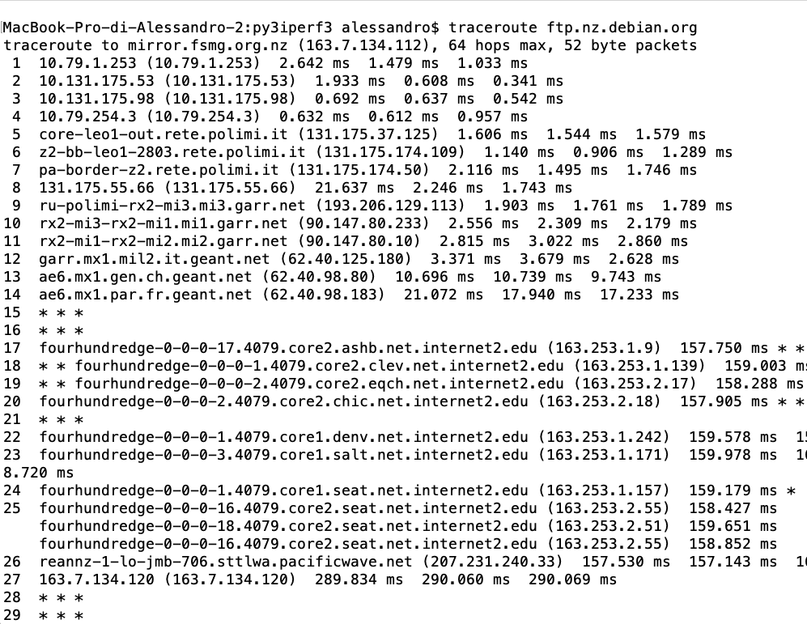
Traceroute

Slide 29
Playing around with ICMP and Colab
We’ll use ICMP to introduce the platform we’ll use for practical activities (and possibly homeworks)
Go to colab.research.google.com

Slide 30
Iperf
iperf is another widely used tool for active network performance measurement:
Client/Server paradigm (must be active on both ends)
Measures UDP/TCP/SCTP/ bandwidth, jitter, packet loss
Cross-platform (Win,Linux,Mac,Android,iOS)

Slide 31
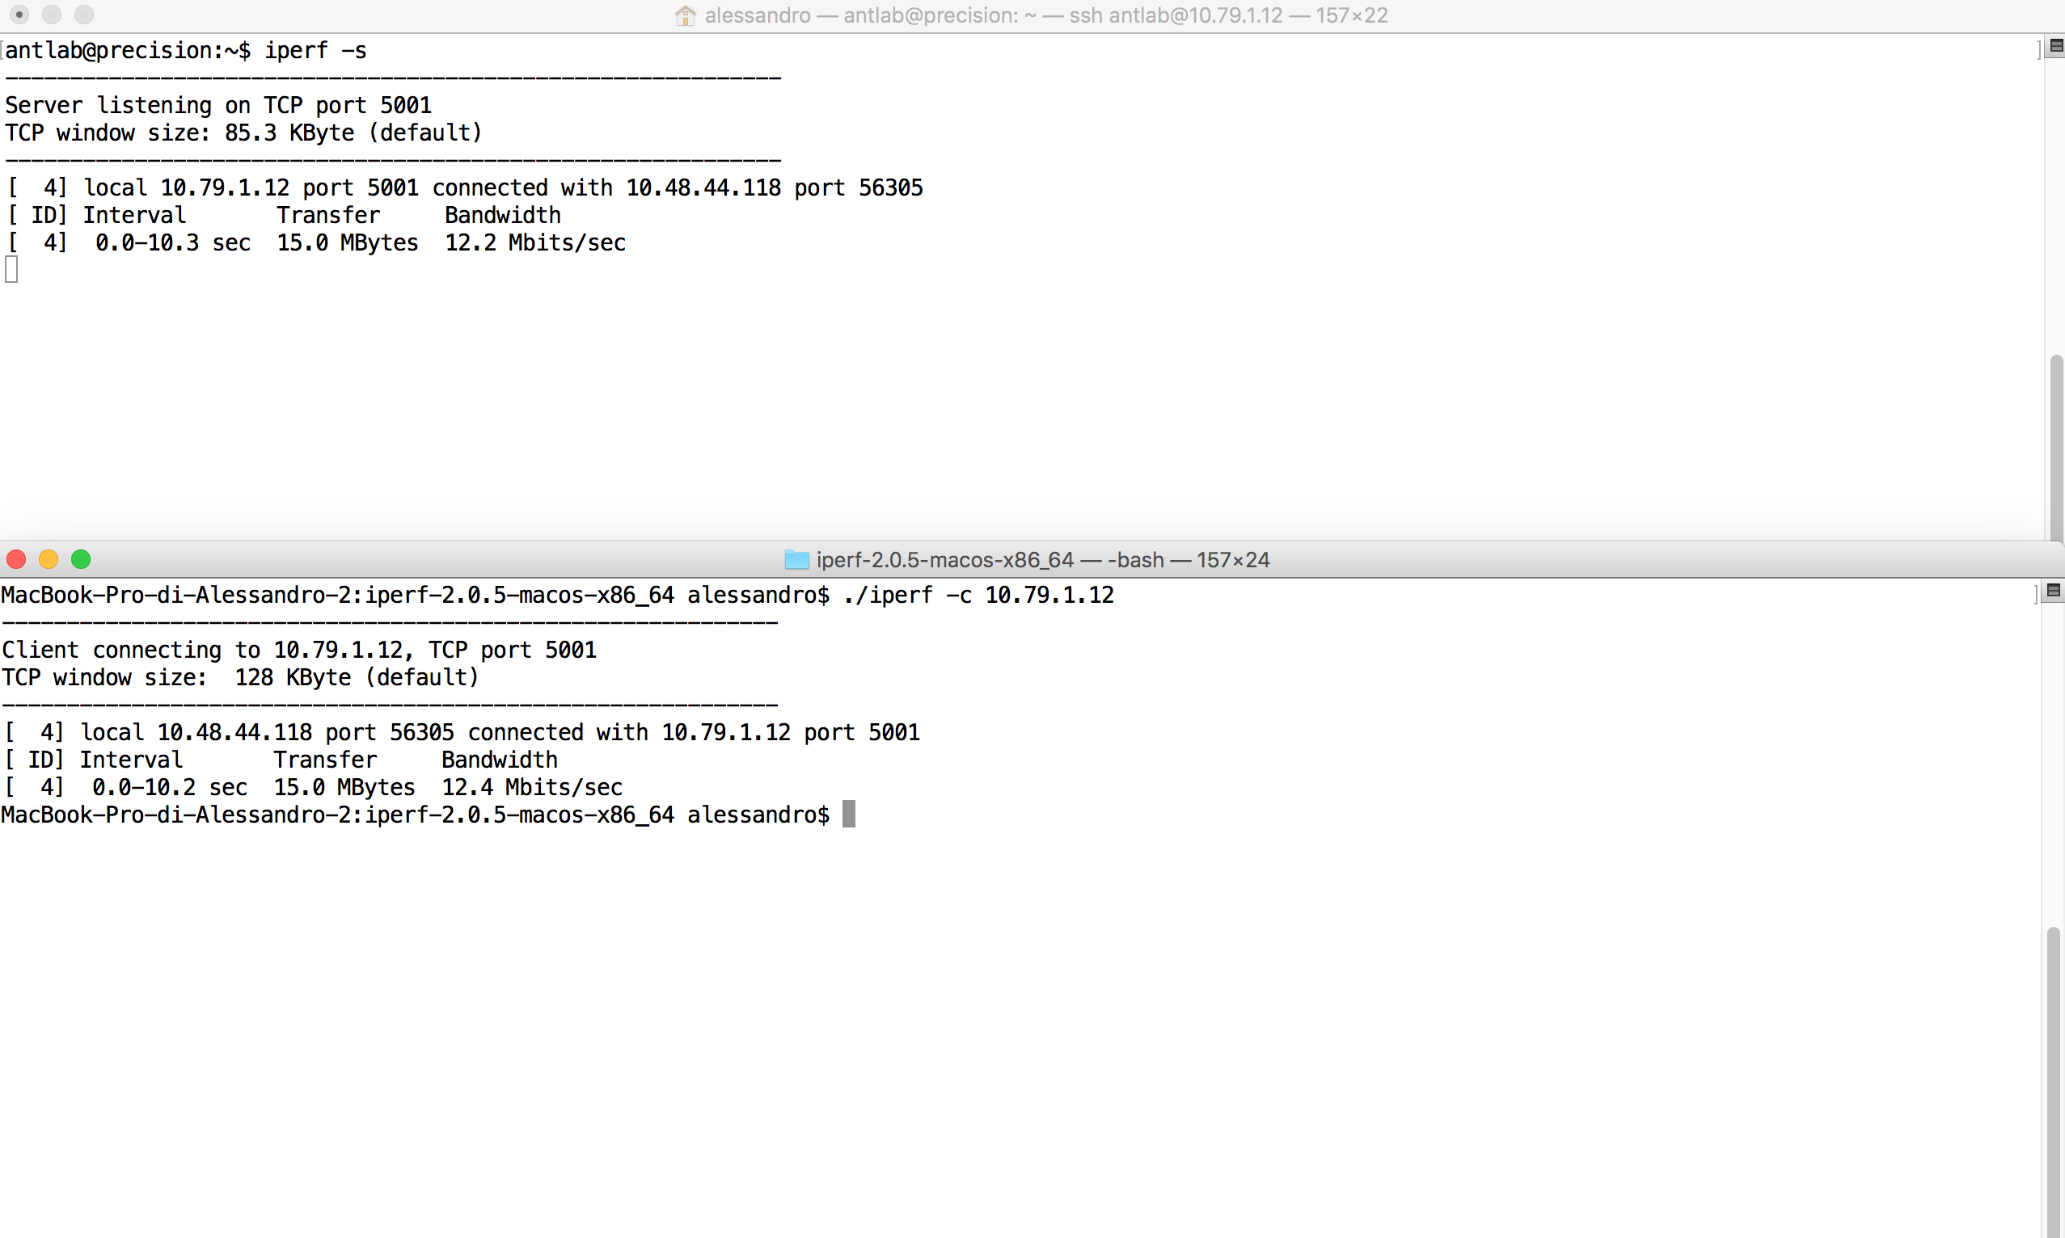
Iperf

Slide 32
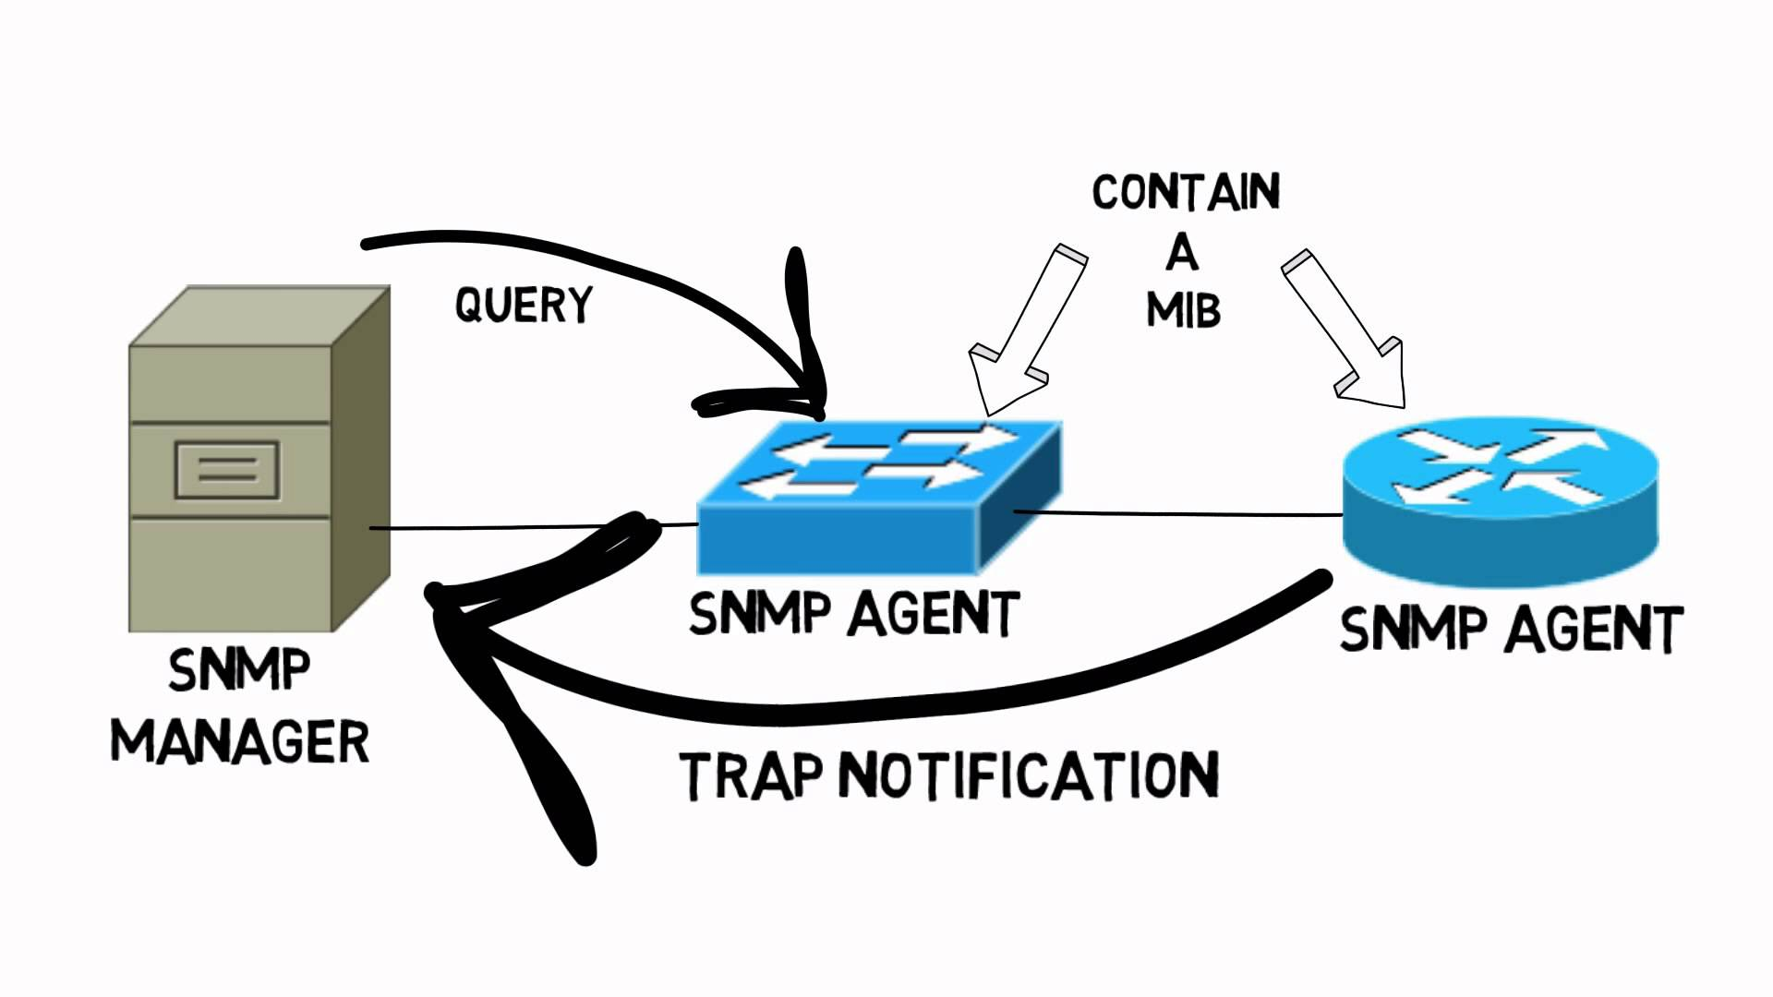
SNMP
Simple Network Management Protocol
Application protocol to get information from network devices. A manager retrieves data from agents running on the network devices.
Data is described in a Management Information Bases (MIB) through OID (Object Identifiers)

Slide 33
SNMP messages
GET messages: transmitted from the manager to ask for information from an agent
SET messages: used to change an agent device configuration
RESPONSE message: transmitted from agents to reply to a GET/SET message
TRAP message: proactively sent by agents to a manager when an unexpected event occurs
INFORM message: similar to TRAP, with ACK.
All messages are transported using UDP (port 161 for GET/SET and RESPONSE, 162 for TRAP and INFORM messages)

Slide 34
OID
An Object IDentifier (OID) corresponds to a node in the OID tree.
The root of the tree defines the standard used (0:ITU-T,1:ISO, 2:joint)
`Dot' notation used to progress into the tree (e.g. 1.3.6.1.2.1.1)
For SNMP, all OID start with 1.3.6.1.2
snmptranslate translates a numerical OID into a `readable’ information
snmpwalk retrieve a subtree of OID using multiple GET messages

Slide 35
SNMP examples
Ask system information to a DEIB network printer (131.175.126.65, 3rd floor). OID: 1.3.6.1.2.1.1.1
Ask number of network interfaces. OID: 1.3.6.1.2.1.2.1
Ask for total bytes tx on the first interface: OID: 1.3.6.1.2.1.2.2.1.10.1

Slide 36
Homework #1
Active Measurements (4 points)

Slide 37
Assignments
You are requested to evaluate the relationship between the (average) RTT and physical distance of two endpoints
The first endpoint could be either your laptop (if you use a local python script) or a Colab VM
The second endpoint should vary and be located at increasing distances from the first endpoint
Hint: Ftp mirror servers are a good source of worldwide disseminated hosts. Some examples:
https://www.gnu.org/prep/ftp.html
https://www.debian.org/mirror/list
Hint: create a csv file of all the servers you want to ping and load it into your notebook (many tutorials are available)

Slide 38
Assignments (0-3 points)
Use your preferred approach to estimate the average RTT
You can use (among others) the geopy.distance.distance() function of the geopy library to get the distance in km between any two pairs of (lat.long) coordinates
Gather a sufficiently diverse set of measurements, including both RTT at very short and very long distances
Plot the obtained measurements on a distance/RTT graph

Slide 39
Assignments (4th point)
A basic approximation for the RTT is a linear function of the physical distance:
RTT = 2(L/C + d/v) + n
Estimate the average RTT per km by fitting a linear function on your set of measurement. Comment your result.
Plot the fitted line over the set of measurements
Hint: take a look at numpy.polyfit function

Slide 40
Evaluation
The following aspects will be considered for evaluation
Technical correctness and completeness
Coding style, level of automation, easiness of interpretation (use comments to explain what you are doing)
Presentation of results (with print(), figures, etc.)

Slide 41
Deadlines
This homework must be delivered by Thu, March 12th, 23:59
Export your code (entire script, notebook or colab link) with any additional resource needed (e.g., csv file) and upload it on the specific folder on WeBeep.

